Slide 1

July 31st, 2020

Slide 2
Agenda:
Autophagy and Longevity
Emily Movsumova, Iana (Yana) Leshchynska, Zara Nadeem, & Zahin Quayyum
Discussion
The Role of Gut Microbiota in Neurological Disorders
David Arce
Discussion
Plans for Fall 2020
Meeting on Friday, August 14th
Research Opportunity Database/Website

Slide 3

Autophagy and Longevity
Emily Movsumova, Iana (Yana) Leshchynska, Zara Nadeem, & Zahin Quayyum

Slide 4




Today’s Presenters
Emily Movsumova
Zara Nadeem
Iana Leshchynska
Zahin Quayyum

Slide 5
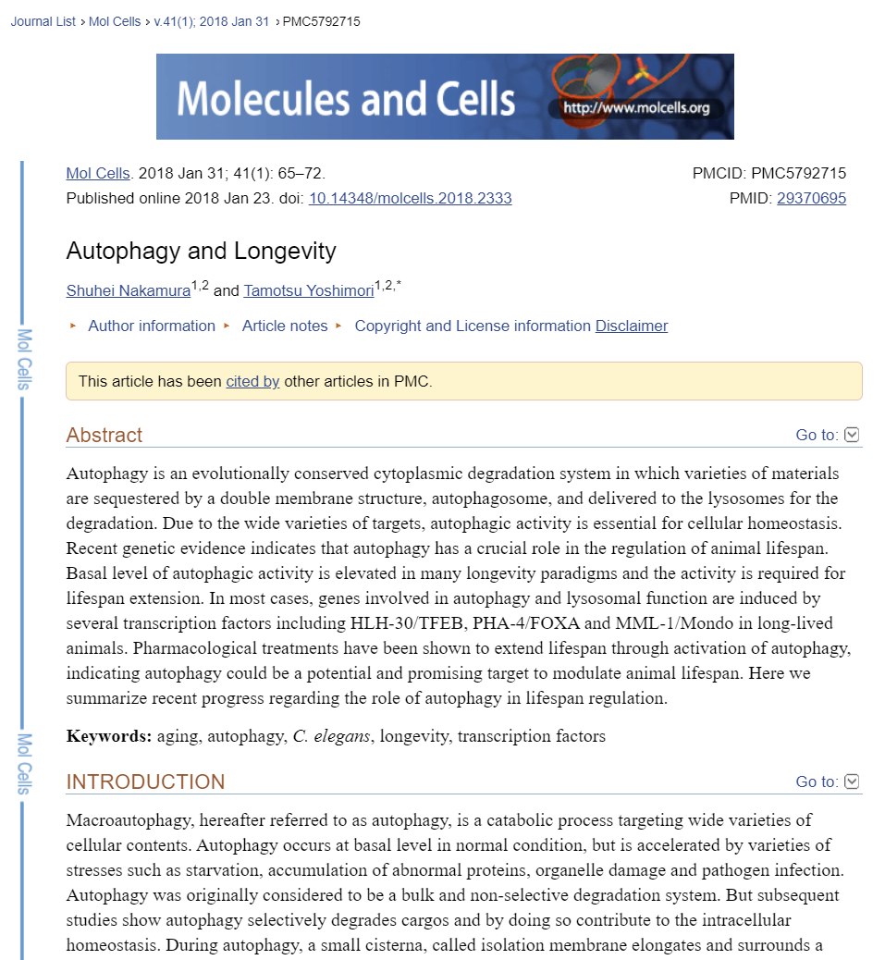
Our Paper
In this mini review, we look into how autophagy is linked and a controller of longevity and longer lifespans in organisms.

Slide 6
01
02
03
Intro to Autophagy
Broader Approach
Definitions
04
05
06
Treatment
Gene regulation
Conclusion
Summary of the cellular process
How autophagy relates to intermittent fasting and longer lifespans
What you need to know
Pharmacological treatments which have been shown to extend animal lifespan
Transcription and genetic factors that play a role in autophagy activation and animal life span
Current and future implications of the study

Slide 7
01
Intro to Autophagy
Summary of the Cellular Process

Slide 8
About Autophagy
What?
Why?
When?
Occurs anytime, but fluctuates when cells are under stress from starvation, organelle damage, and pathogen infection.
Autophagy is a catabolic (breakdown) process common in all cells.
The main purpose is to remove old and dysfunctional organelles and cellular components.

Slide 9
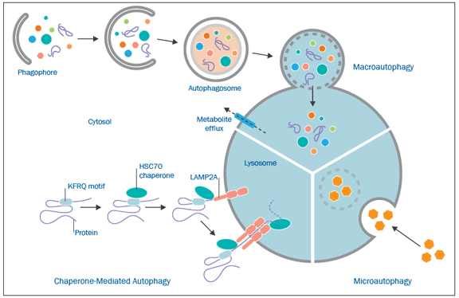
Three different types of Autophagy
We will focus on Macroautophagy as it is the one discussed in the paper.

Slide 10
Three different types of Autophagy
We will focus on Macroautophagy as it is the one discussed in the paper.

Slide 11
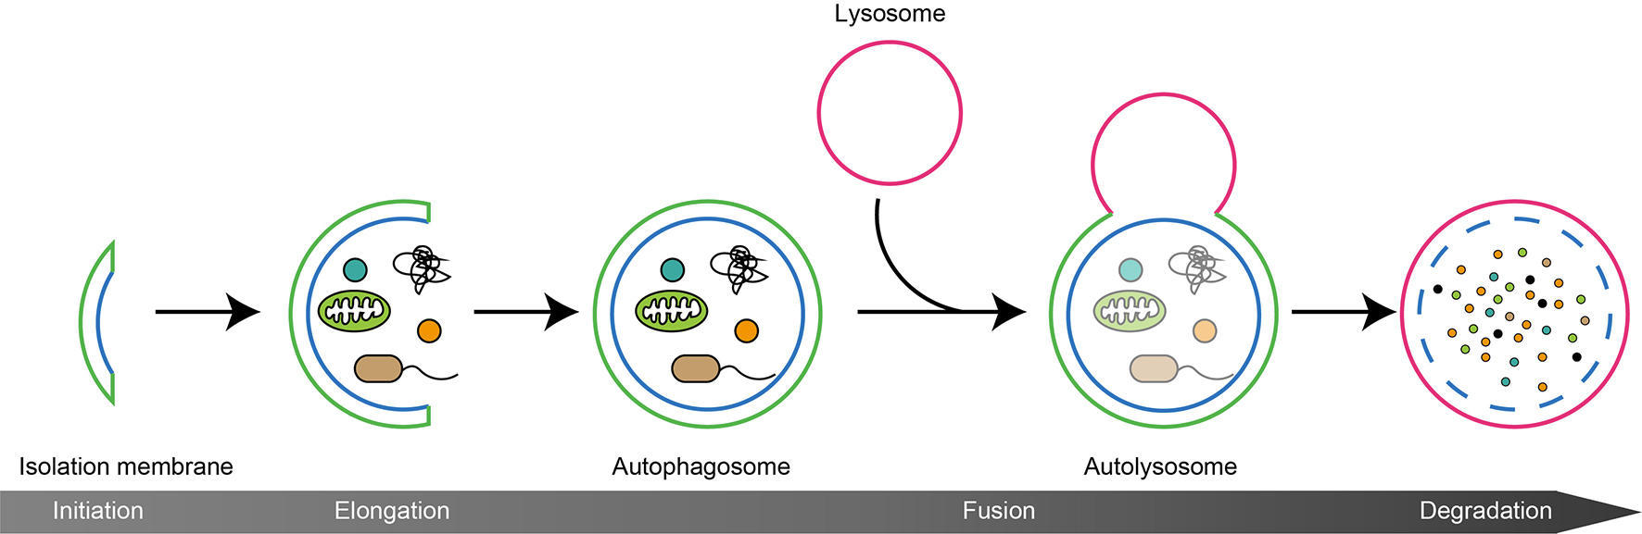
Process of Macroautophagy (Figure 2)
Isolation membrane: portion of phospholipid bilayer that eventually forms an autophagosome
Autophagosome: preliminary unit of cellular contents to be degraded
Lysosome: a membrane-bound organelle that contains digestive enzymes
Autolysosome: the fused unit of the autophagosome & lysosome; where the lysosomal
enzymes breakdown the contents of this unit.

Slide 12
02
Broader Approach
How autophagy relates to intermittent fasting and longer lifespans

Slide 13
Autophagy in a Broader Conversation
Cancer
Liver Health
Immune System
Disease
Autophagy is vital for cells - it cleans out dysfunctional parts and further reused in other applications
Autophagy could stall the development of cancerous cells, but may also promote their growth (depending on the stage & type of tumor).
Autophagy protects liver cells from injuries caused by drug and alcohol damage.
Autophagy increases under stress and also shown to help to enhance the immune system & response.
Autophagy helps to clear cells of toxic buildup & inflammation, and shown to protect against neurodegenerative and infectious diseases.

Slide 14
Two Related Topics for Discussion
Intermittent Fasting
Insulin Control
Longer Life Spans
In recent studies, intermittent fasting has been shown to induce and promote autophagy.
This implies cells remain efficient and healthy.
Increasing autophagy in mice cells enhances insulin signaling and can aid in diabetic therapy.
This paper focuses on how autophagy can contribute to living longer and related to the process of aging.

Slide 15
03
Definitions
What you need to know

Slide 16
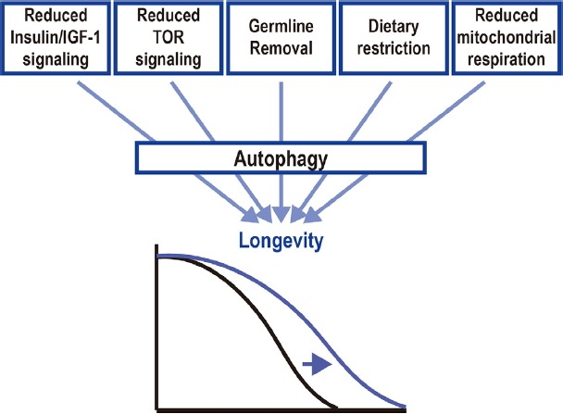
Important Concepts
Figure 2
This figure will pop up frequently in our presentation so it will be important to understand each point.
It is a simple summary of how these 5 factors play into the process of autophagy thereby increasing longevity.

Slide 17
Important Concepts
These 5 factors are molecular mechanisms found in cells.
In this paper, this is what was found to “delay aging” and “extend lifespan”.
They are “evolutionarily conserved molecular mechanisms”.
Meaning… the genes that express these molecular mechanisms have not changed very much through the course of evolution.
These sets of genes can be found similar in many different organisms
These 5 mechanisms have been identified through model organisms of yeast, worms, fly and mice.

Slide 18
Reduced Insulin/IGF-1 Signaling
Decreased signaling of insulin & growth hormone
Usually seen in starving cells who postpone development as their metabolism shifts to the create & use fat reserves until food becomes more abundant
Autophagy activity is elevated -- evidence of increased autophagic vesicles
Decreased signaling pathway extends lifespan in Drosophila (fruit flies) and mice
Furthermore, Human centenarians (ages 100-109) have mutations in the signalling pathway
Less growth hormones - lower body height & increased “old-age survival” in women

Slide 19
Reduced TOR signaling
This cell signalling pathway “senses growth factors, nutrient or oxygen status and promote appropriate changes” in the cell
These changes include the cell’s growth & proliferation, cell survival, and protein synthesis.
Inhibition of this pathway induces autophagy
This is done using rapamycin which specifically binds to mTOR (a nutrient sensor) and activates the autophagy of cells.

Slide 20
Germline Removal
In many species, increased reproduction decreases longevity
Germline stem cells are stem cells responsible for the continuous production of reproductive components (gametes, sperms, and eggs).
Removed (using laser microsurgery or genetic mutation) extended lifespan in C. elegans (roundworms) and Drosophila (fruit flies).
In a study, along with TOR, overexpression of a gene related to fats in cells showed that increased lipid turnover by autophagy is essential for longevity.

Slide 21
Dietary Restriction
It has been studied heavily that Dietary restriction is a well known way to slow aging and extend lifespan
This is related to Reduced Insulin/IGF-1 Signalling & Reduced TOR signaling.
Cell dietary restriction is induced by amino acid limitation -- and thus induces autophagy

Slide 22
Reduced Mitochondrial Respiration
The free radical theory is based on the idea that “aging is the cumulative result of oxidative damages to cells and tissues over time”.
The oxidative damages to cells are caused by reactive oxygen species (ROS) mainly as a result of mitochondrial respiration.
By reducing mitochondrial respiration it was found that it extended the lifespan of many organisms
Done by mutants targeting genes involved in the electron transport chain in the mitochondria.

Slide 23
Figure Conclusion
Overall, these 5 mechanisms contribute to inducing autophagy.
In the next part of the presentation, we will discuss specific compounds and get a closer look into the genes that have been found to increase autophagy.

Slide 24
04
Treatment
Pharmacological treatments which have been shown to extend animal lifespan

Slide 25
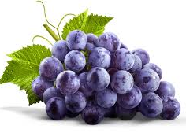
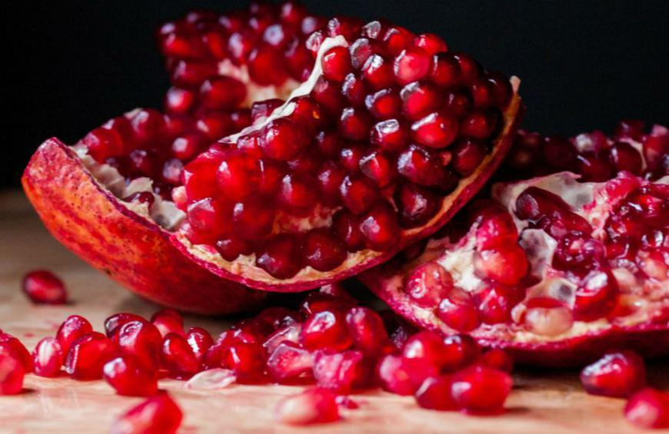

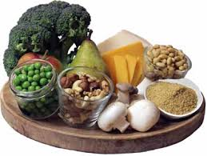
Pharmacological treatments
Resveratrol
Urolithin A
Spermidine
Tomatidine
Resveratrol is a naturally occurring polyphenolic compound found in grapes
Urolithin A as a first-in-class natural compound that induces mitophagy both in vitro and in vivo following oral consumption
Spermidine, a naturally occurring polyamine, has recently emerged as exhibiting anti-aging properties
Tomatidine, a natural compound abundant in unripe tomatoes

Slide 26
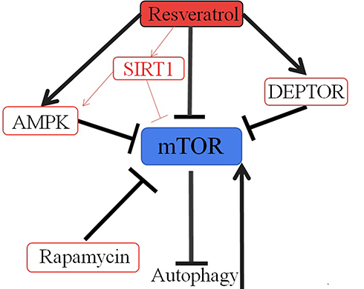
Resveratrol
Resveratrol is a naturally occurring polyphenolic compound found in grapes and an activator of the NAD-dependent histone deacetylase sirtuin (SIRT1).
Administration of resveratrol is known to extend the lifespan of several model organisms (Park et al., 2013).
Especially, the lifespan extension in C. elegans seems to be dependent on autophagy since resveratrol fails to extend the lifespan of bec-1 (RNAi) treated animals.
These observations are in agreement with findings in mammalian cells, where pharmacological activation of SIRT1 by resveratrol treatment stimulates autophagic flux.

Slide 27
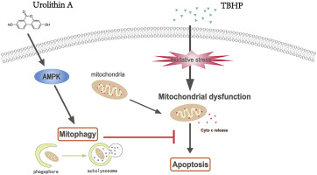
Urolithin A
Urolithin A as a first-in-class natural compound that induces mitophagy both in vitro and in vivo following oral consumption.
In C. elegans, urolithin A prevents the accumulation of dysfunctional mitochondria with age and extends lifespan (Ryu et al., 2016).
Likewise, Urolithin A prolongs normal activity during aging in C. elegans, including mobility and pharyngeal pumping, while maintaining mitochondrial respiratory capacity.
These effects are observed in rodents, where Urolithin A improves exercise capacity in two different mouse models of age-related decline of muscle function, as well as in young rats.

Slide 28
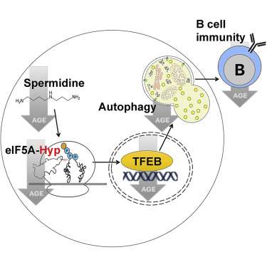
Spermidine
Administration of a natural polyamine, spermidine provides beneficial for health in a number of species and extends lifespan of yeast, worms, flies and mice (Eisenberg et al., 2009; 2016).
This, in turn, correlates with transcriptional upregulation of multiple autophagy-related genes, including Atg5 and Lc3/ATG8/lgg-1/2 (Eisenberg et al., 2009).
In keeping with this observation, spermidine fails to extend the lifespan of C. elegans subjected to bec-1 RNAi, whereas it increases the expression of DsRed::LGG-1 (Eisenberg et al., 2009)
In flies, spermidine alters the expression of autophagy markers, protects against age-induced memory loss in an autophagy-dependent manner, and extends the lifespan in an Atg7-dependent manner (Gupta et al., 2013).

Slide 29
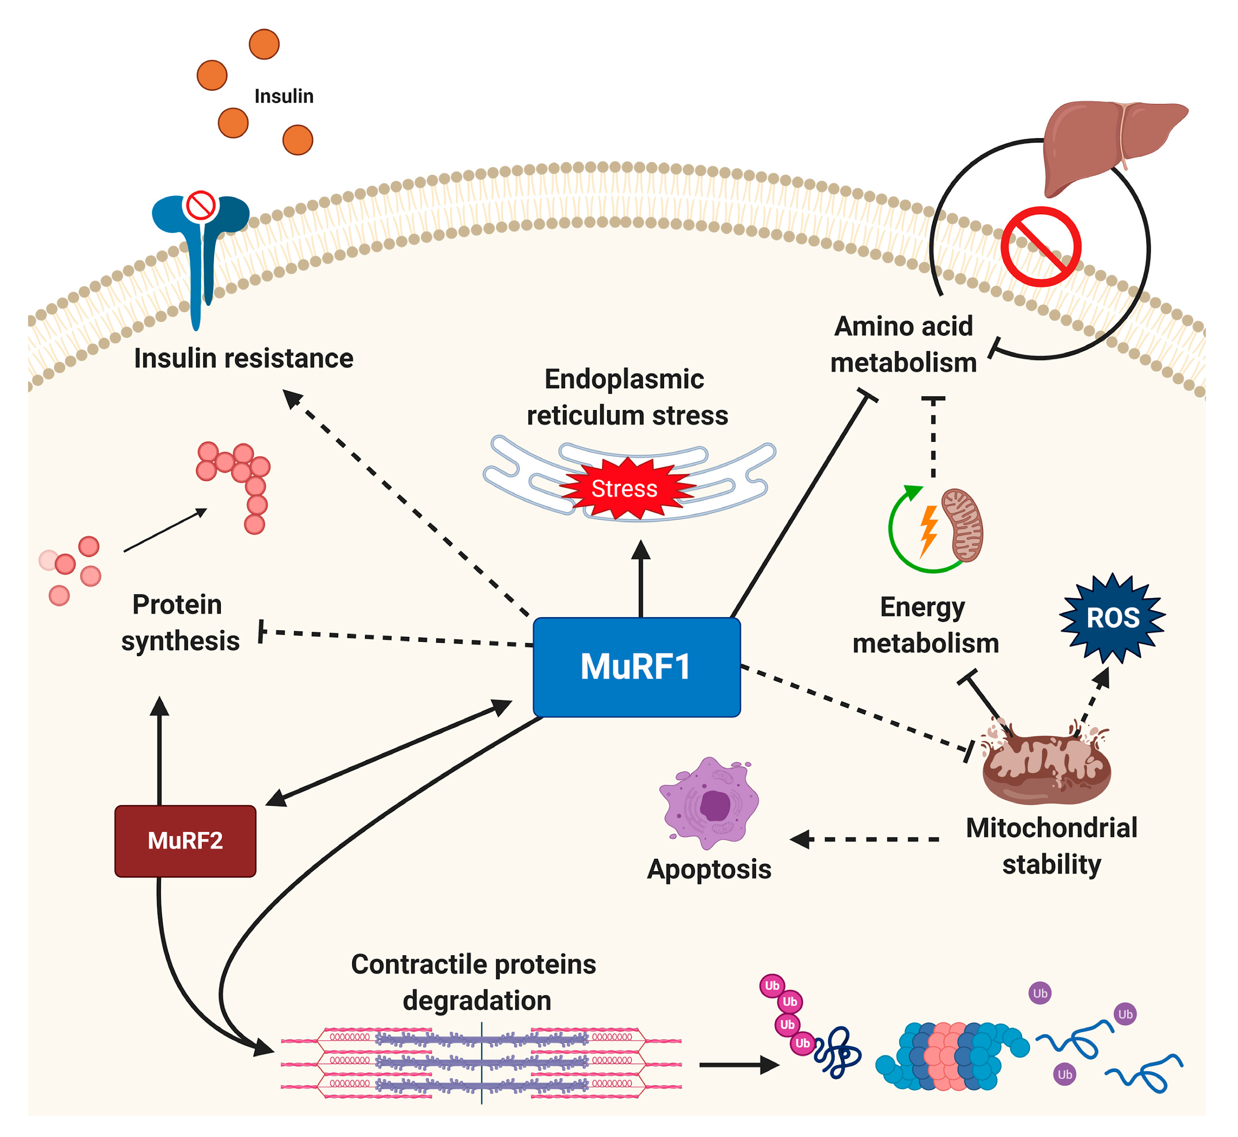
Tomatidine
Tomatidine, a natural compound abundant in unripe tomatoes, inhibits age-related skeletal muscle atrophy in mice.
Recent study shows that tomatidine extends lifespan and healthspan in C. elegans (Fang et al., 2017). Tomatidine improves many C. elegans behaviors related to healthspan and muscle health, including increased pharyngeal pumping, swimming movement, and reduced percentage of severely damaged muscle cells.
Microarray, imaging, and behavioral analyses reveal that tomatidine maintains mitochondrial homeostasis by modulating mitochondrial biogenesis and PINK-1/DCT-1-dependent mitophagy.
Detailed analysis shows tomatidine induces mitochondrial hormesis by mildly inducing ROS production, which in turn activates the SKN-1/Nrf2 pathway and possibly other cellular antioxidant response pathways, followed by increased mitophagy.

Slide 30
05
Gene regulation
Transcription and genetic factors that play a role in autophagy activation and animal life span

Slide 31

Autophagy regulators relevant for longevity
HLH-30/TFEB
Transcription factor that regulates the synthesis of lysosomes, which is linked to regulating autophagy and fat metabolism.
Transcription factor EB (TFEB) is a central regulator of autophagy. HLH-30 protein is a homologous gene of TFEB and plays a broad role in C. elegans lifespan determination.
TFEB is known to be negatively regulated by nutrient sensor TOR.
HLH-30 is translocated to the nucleus by inhibition of Insulin/IGF-1 signaling, mitochondrial respiration, TOR signaling, and germline removal.

Slide 32
Autophagy regulators relevant for longevity
MML-1/Mondo
Transcription factor complex (MML-1/MXL-2) required for the longevity in C. elegans.
Regulate TFEB via TOR inhibition to promote longevity
Inhibition of MML-1/MXL-2 → impairs HLH-30 nuclear localization → impairs activation of autophagy in germline

Slide 33
Autophagy regulators relevant for longevity
Forkhead transcription factors (daf-16/FOXO, pha-4/FOXA)
Forkhead box (FOX) proteins are a large family of transcription factors with important functions in multiple biological processes, such as cell cycle control, cell differentiation, proliferation and development
In C. elegans, Drosophila and mice, reduction of Insulin/IGF-1 signaling ultimately activates DAF-16/FOXO function and extends lifespan. In worms, DAF-16 increased autophagy.
PHA-4/FOXA binds to the promoter region of transcription genes, which work in early stage of autophagosome formation and upregulates these genes in worms, leading to autophagic activation.

Slide 34
Autophagy regulators relevant for longevity
miR-34
MicroRNA: small noncoding RNAs that regulate gene expression at the post transcriptional level.
Reduce microRNA expression → increase autophagy activity → increase longevity
In worms, loss of function of miR-34 extends lifespan. miR-34 expression increases with age and represses the worm’s autophagy gene, Atg9a.
In contrast, increased mir-34 levels extend lifespan and reduce the neurodegeneration in Drosophila.

Slide 35
Autophagy regulators relevant for longevity
Sirtuins
Family of proteins involved in cellular health and metabolic regulation.
NAD-dependent deacetylase SIRT1 is a well-known modulator of aging. The life spans of yeast, worms, and flies can be extended by the overexpression or pharmacological activation of SIRT1.
SIRT1 regulates autophagy gene expression through histone deacetylation

Slide 36
06
Conclusion
Summary of the study’s findings and implications

Slide 37
Conclusion
There is substantial evidence that autophagy is essential for longevity, but there are multiple factors to be considered...
How does timing affect the benefits of autophagy?
A 2017 showed that worms who went through an autophagy knockdown after the reproductive period was shown to extend lifespan in worms.
What is specific cargo that are related to aging that autophagy degrades?
The paper clarifies that degradation of lipids (lipophagy) and degradation of mitochondria (mitophagy) were factors in aging in C. elegans
How can we effectively monitor autophagy activity in humans?
Assessing the role of autophagy in other diseases
How can autophagy affect the outcomes of certain diseases?

Slide 38
References
Bagherniya, Mohammad, et al. “The Effect of Fasting or Calorie Restriction on Autophagy Induction: A
Review of the Literature.” Ageing Research Reviews, vol. 47, Nov. 2018, pp. 183–97. ScienceDirect, doi:10.1016/j.arr.2018.08.004
“Chaperone Mediated Autophagy (CMA) Does It All!” Novus Biologicals, 9 Jan. 2018,
https://www.novusbio.com/antibody-news/antibodies/chaperone-mediated-autophagy-cma-does-it-all.
Gammoh, Noor, et al. “Role of Autophagy in Histone Deacetylase Inhibitor-Induced Apoptotic and Nonapoptotic Cell Death.” Proceedings of the National Academy of Sciences, vol. 109, no. 17, Apr. 2012, pp. 6561–65. www.pnas.org, doi:10.1073/pnas.1204429109.
Heemst, Diana Van, et al. “Reduced Insulin/IGF-1 Signalling and Human Longevity.” Aging Cell, vol. 4, no. 2, 2005, pp. 79–85. Wiley Online Library,
doi:10.1111/j.1474-9728.2005.00148.x.
Jiang, Guan-Min, et al. “The Relationship between Autophagy and the Immune System and Its Applications for Tumor Immunotherapy.” Molecular Cancer, vol. 18, no. 1,
Jan. 2019, p. 17. BioMed Central, doi:10.1186/s12943-019-0944-z.
“Lysosome.” Genome.Gov, https://www.genome.gov/genetics-glossary/Lysosome.
Lin, Xin-Xuan, et al. “DAF-16/FOXO and HLH-30/TFEB Function as Combinatorial Transcription Factors to Promote Stress Resistance and Longevity.” Nature Communications, vol. 9, no. 1, Dec. 2018, p. 4400. DOI.org, doi:10.1038/s41467-018-06624-0.
Lin, Xiaokun, et al. “Rapamycin Inhibits Proliferation and Induces Autophagy in Human Neuroblastoma Cells.” Bioscience Reports, vol. 38, no. 6, Nov. 2018. PubMed
Central, doi:10.1042/BSR20181822.
Nakamura, S., & Yoshimori, T. (2018). Autophagy and Longevity. Molecules and cells, 41(1), 65–72. https://doi.org/10.14348/molcells.2018.2333
O’Brien, Jacob, et al. “Overview of MicroRNA Biogenesis, Mechanisms of Actions, and Circulation.” Frontiers in Endocrinology, vol. 9, Aug. 2018, p. 402. DOI.org, doi:10.3389/fendo.2018.00402.
“Our Core Science - Why Sirtuins Are Important.” Elysium Health, https://www.elysiumhealth.com/en-us/science-101/why-sirtuins-are-important-for-aging.
Rubinsztein, David C., et al. “Therapeutic Targeting of Autophagy in Neurodegenerative and Infectious Diseases.” The Journal of Experimental Medicine, vol. 212, no. 7,
June 2015, pp. 979–90. PubMed Central, doi:10.1084/jem.20150956.
TOR Signalling - Latest Research and News | Nature. https://www.nature.com/subjects/tor-signalling. Accessed 31 July 2020.
Wen, Xin, and Daniel J. Klionsky. “At a Glance: A History of Autophagy and Cancer.” Seminars in Cancer Biology, Nov. 2019. ScienceDirect,
doi:10.1016/j.semcancer.2019.11.005.
Williams, Jessica A., and Wen-Xing Ding. “Role of Autophagy in Alcohol and Drug-Induced Liver Injury.” Food and Chemical Toxicology, vol. 136, Feb. 2020, p. 111075.
ScienceDirect, doi:10.1016/j.fct.2019.111075.
Yamamoto, Soh, et al. “Autophagy Differentially Regulates Insulin Production and Insulin Sensitivity.” Cell Reports, vol. 23, no. 11, June 2018, pp. 3286–99. PubMed
Central, doi:10.1016/j.celrep.2018.05.032.
Zhang, Wentao, et al. “The Emerging Roles of Forkhead Box (FOX) Proteins in Osteosarcoma.” Journal of Cancer, vol. 8, no. 9, 2017, pp. 1619–28. DOI.org (Crossref), doi:10.7150/jca.18778.

Slide 39
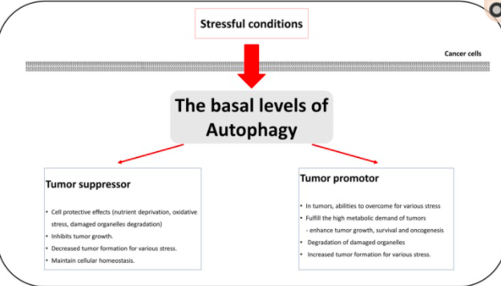
Role of Autophagy in Cancer
Autophagy → great for tumor suppression AND tumor survival??

Slide 40

Citation
Yun CW, Lee SH. The Roles of Autophagy in Cancer. Int J Mol Sci. 2018;19(11):3466. Published 2018 Nov 5. doi:10.3390/ijms19113466
happy birthday deep <3

Slide 41
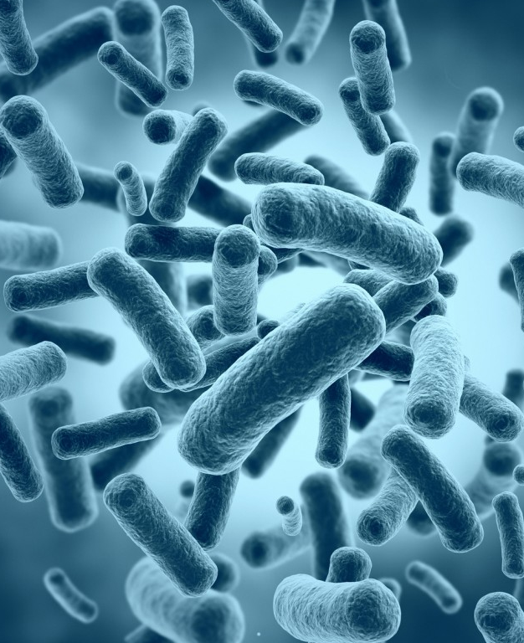
The Role of Gut Microbiota in Neurological Disorders
DAVID ARCE

Slide 42
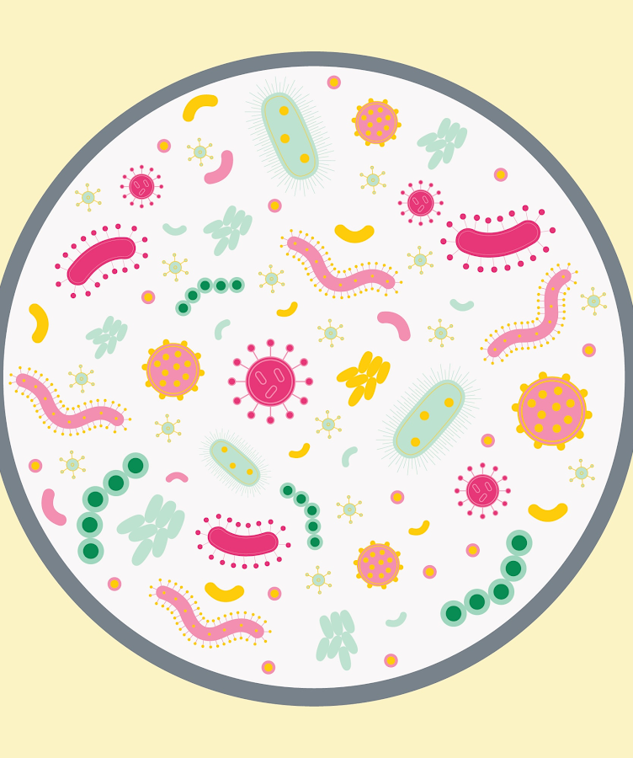
What is the Gut Microbiota?
Microbiota - the microorganisms living in a location
Gut microbiota- the microorganisms (bacteria, viruses, and fungi) that live in the gut

Slide 43
The Importance of the Gut Microbiota
Humans have evolved to live with microbes
The gut microbiome begins to affect your body the moment you are born
Babies are exposed to microbes when they pass through the mother's birth canal
The microbiome becomes more diverse as children develop; a higher diversity correlates with good health
The gut microbiome is very important for our overall survival

Slide 44

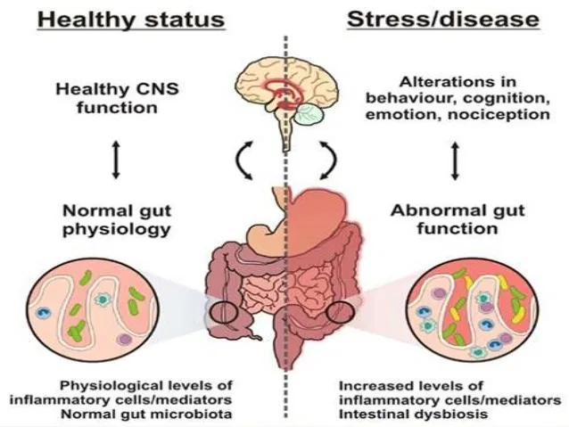
The Role of Gut Microbiota in the Body
Digests breast milk
Digests fiber
Helps control the immune system
Helps control brain health

Slide 45



The Microbiota-Gut-Brain Axis
The bidirectional communication between the gut microbiota and the brain
Influences the behavior associated with neuropsychiatric conditions
Occurs through various pathways: vagus nerve, immune system, neuroendocrine pathways, and bacteria-derived metabolites

Slide 46
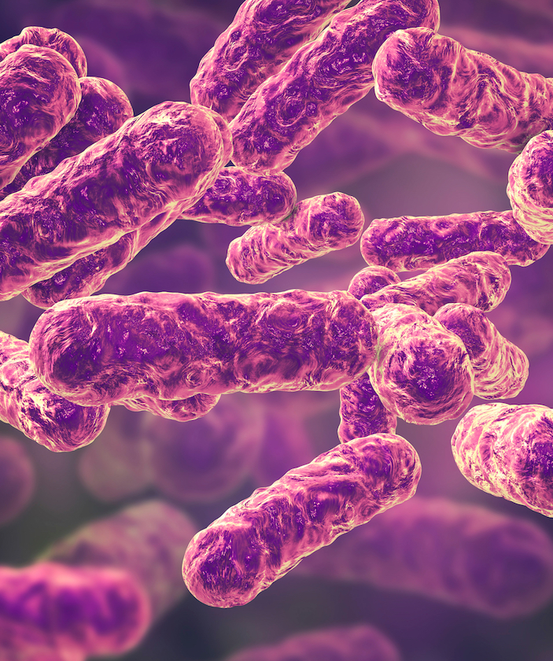
"Recent developments in understanding the role of the gut microbiota in brain health and disease"
How the gut microbiota affects:
Stress-related disorders
Neurodegenerative disorders
Sociability and neurodevelopmental disorders

Slide 47
Depression
Not many clinical studies that have performed microbiota analysis in depressed patients have been conducted
We rely more on animal studies
Dysregulation – reduction in species richness and microbial diversity

Slide 48
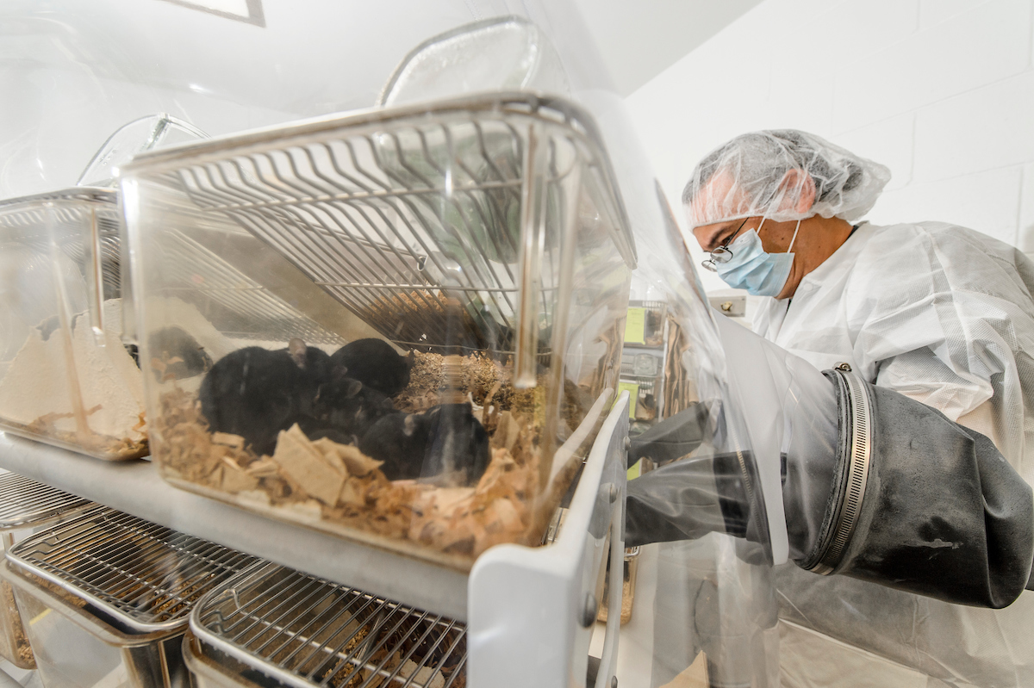
Depression
Microbiota transplant
Fecal microbiotas of depressed patients were placed into germ free rats
Germ free- have not been exposed to microbes; "empty microbiota"

Slide 49
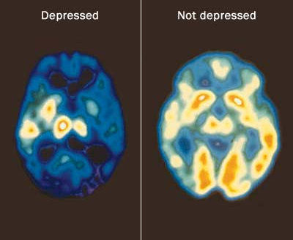
Depression
The germ-free rats developed depressive-
related phenotypes
These rats had a dysregulated microbiota
Elevated kynurenine / tryptophan ratio
The dysregulated microbiota was converting tryptophan into kynurenine

Slide 50
Alzheimer's Disease
Most common cause of dementia
Its cause is unknown
Cognitive impairments (long-term memory loss), physical disability, and exhaustion
Buildup of amyloid plaques and Tau protein
Widespread neuroinflammation

Slide 51
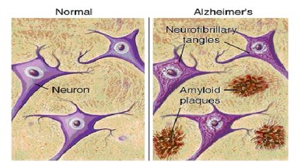
Amyloid Plaques and Tau Protein
Amyloid plaques – accumulations of beta amyloid proteins that clump together between neurons
Tau protein- a component of microtubules; it collapses into neurofibrillary tangles, preventing nutrients from entering the cell.

Slide 52
The Gut Microbiota and Alzheimer's Disease
Studies examined patients’ fecal samples
Increases in bacteria that are associated with mediating inflammation
The increase of these bacteria positively correlated with an increase in proinflammatory cytokines
A link between dysregulation of the microbiota and systemic inflammation

Slide 53
Bacterial Translocation
Bacteria or bacterial components can translocate from the lumen of the gut and mediate systemic neuroinflammation
Levels of bacterial components and the E. coli K99 pilli protein have been found to be higher in the brain tissue and blood vessels of patients
Some of these bacterial components were also found in amyloid plaques

Slide 54
Parkinson's Disease
Progressive nervous system disorder that affects movement
Cannot be cured; medications and treatments improve symptoms
Symptoms:
Tremors
Slowed movement
Muscle stiffness
Impaired posture and balance
Decreased ability to perform unconscious movements

Slide 55
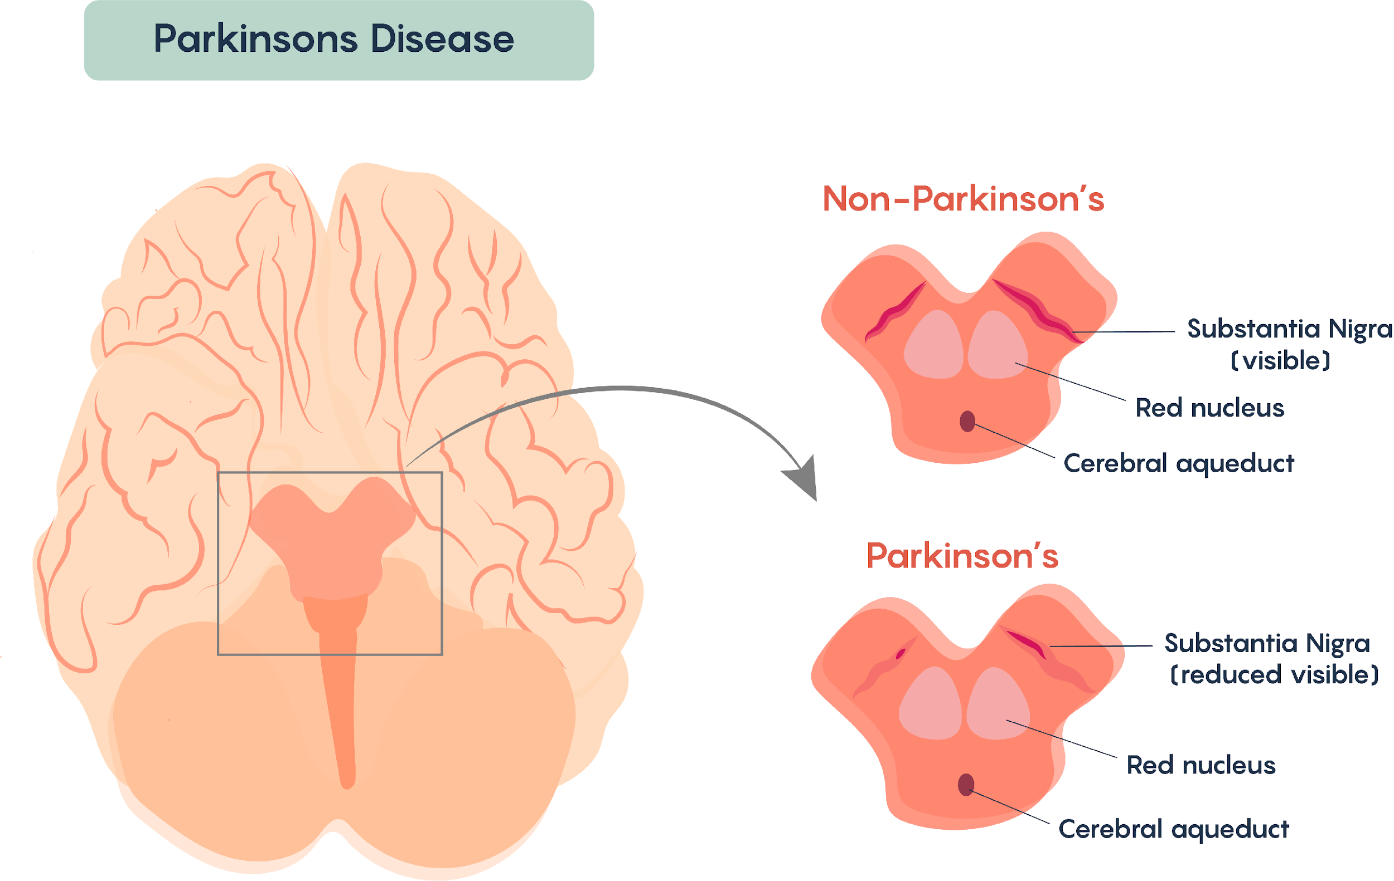
Parkinson's Disease in the Brain
Degeneration of the substantia nigra in the mid-brain
Neuroinflammation

Slide 56
How the Gut affects Parkinson's Disease
Constipation is often reported
Gastrointestinal problems become exacerbated
As there are gastrointestinal disturbances, it makes sense that the microbiota-gut-brain axis is affected

Slide 57
Parkinson's Disease
Studies examined fecal samples; reduced abundance of bacteria that produce mucin.
Mucin enhances the intestine's integrity
A reduction of this bacteria may lead to intestinal permeability and bacterial translocation
Fecal microbiota contained lower levels of anti-inflammatory associated bacteria and higher levels of proinflammatory-associated bacteria.
Could be associated with the neuroinflammation observed in Parkinson's disease.

Slide 58



Other Observations
Lower levels of SCFAs (microbial metabolites)
Small intestine bacterial overgrowth
Helicobacter pylori infection

Slide 59
Helicobacter pylori infection
H. pylori infection can contribute to the development of Parksonian symptoms.
Removing H. pylori has been shown to enhance the onset time of levodopa and improve symptoms such as tremors, rigidity, and walking ability.

Slide 60
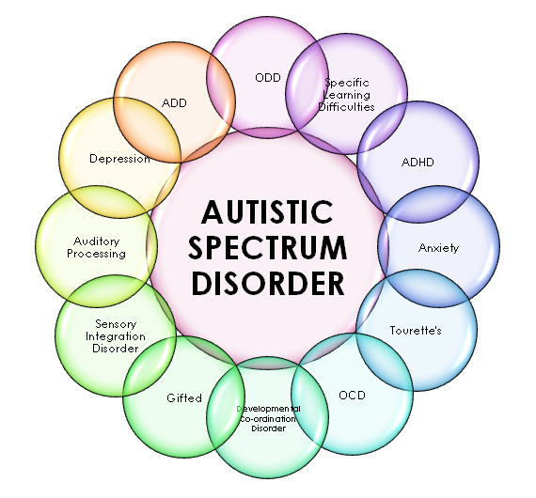
Autism spectrum disorder
Pervasive developmental disorder
Social communication deficit
Repetitive or restricted behaviors or interests
This Photo by Unknown author is licensed under CC BY-SA.

Slide 61
Animal Models of Autism Spectrum Disorder
The concept that gut microbiota may influence social behavior arose from experiments with germ-free mice
In animal models of autism spectrum disorder, there is an altered microbiota composition
The in utero valproate animal model
Induces an autism-like behavior in rats and mice
The new-born mice (pups) displayed an autism-like phenotype along with intestinal inflammation and dysregulation of the microbiota

Slide 62
Animal Models of Autism Spectrum Disorder
Genetic animal model of autism: BTBR animal model
This model displays an autistic-like phenotype
There is microbiota dysregulation
Reduction in the Firmicutes / Bacteroidetes ratio
Reduction in Bifidobacterium species
Increases in Akkermansia muciniphilia

Slide 63
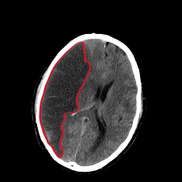
Stroke
When the blood supply to a part of the brain is interrupted or reduced
Prevents brain tissue from getting oxygen and nutrients
Brain cells die in minutes
This Photo by Unknown author is licensed under CC BY-SA.

Slide 64
The Gut Microbiota and Stroke
Alterations to the human microbiota were observed following stroke
Microbial metabolism was affected
Middle Cerebral Artery Occlusion (MCAO) preclinical model
Cerebral ischemia is associated with a dysregulation of the microbiota
Reductions in intestinal motility
Intestinal barrier dysfunction
Increased intestinal permeability

Slide 65
The Gut Microbiota and Stroke
Microbial-derived metabolites may influence stroke susceptibility through modulating platelet activation and thrombosis.
Trimethylamine N-oxide and increased risk for thrombosis
A dysregulated poststroke microbiota was transplanted into germ-free mice, causing increases in the cerebral damage mediated by middle cerebral artery occlusion
Associated with increased trafficking of proinflammatory T lymphocytes from the gut to the brain

Slide 66
Potential Therapies
Using probiotic and prebiotic mixtures may be appropriate therapies for depression and autism
Microbiota transplants
Diet

Slide 67


What should be done next?
Host genetics relate to gut microbiota
How does the gut microbiota modulate behavior (such as in autism)?
More clinical studies and trials

Slide 68
References
Cantu-Jungles, T. M., Rasmussen, H. E., & Hamaker, B. R. (2019). Potential of Prebiotic Butyrogenic Fibers in Parkinson's Disease. Frontiers in Neurology, 10. doi:10.3389/fneur.2019.00663
Khatri, M. (2020, May 28). Your Gut Bacteria and Your Health. Retrieved July 31, 2020, from https://www.webmd.com/digestive-disorders/what-your-gut-bacteria-say-your-health
Mabunga, D. F., Gonzales, E. L., Kim, J., Kim, K. C., & Shin, C. Y. (2015). Exploring the Validity of Valproic Acid Animal Model of Autism. Experimental Neurobiology, 24(4), 285-300. doi:10.5607/en.2015.24.4.285
Reynolds, G. (2014, October 01). How Exercise May Protect Against Depression. Retrieved July 31, 2020, from https://well.blogs.nytimes.com/2014/10/01/how-exercise-may-protect-against-depression/
Sherwin, E., Dinan, T. G., & Cryan, J. F. (2017). Recent developments in understanding the role of the gut microbiota in brain health and disease. Annals of the New York Academy of Sciences, 1420(1), 5-25. doi:10.1111/nyas.13416

Slide 69
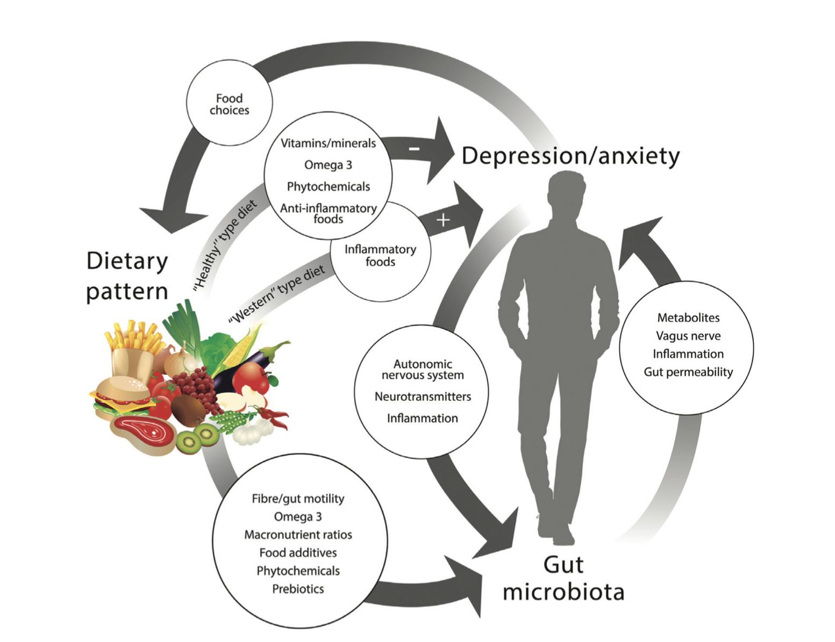
Discussion
The Relationship Between the Gut-Microbiota and Depression
From the research article “The Role of the Gut Microbiota in Dietary Interventions for Depression and Anxiety” by Bear et al. (2020)
Recent research has been focusing on 1) the relationship between diet and mood and 2) the role of gut microbiota on neurology and behavior, called the microbiome-gut-brain axis (MGBA).
Evidence shows that both an individual’s diet and gut-microbiota have a strong influence on emotional behavior.

Slide 70
Specific dietary patterns have been found to help prevent depression and anxiety.
Studies have shown that a lower incidence of depression occurs in adults who have “healthy” eating patterns. This is characterized by having an abundance of vegetables, fruits, etc.
Having a diet that consists of sweet and fatty foods is associated with a higher depression incidence.
It is important to take into account that not all studies showed this pattern or may not have found diet to be associated in any way.
Have any of you ever found your mood to change when eating certain foods?

